Slide 1
Employee
Attrition
TakenMind Project - Proof of Concept
By: Jack Praveen Raj Ilango

Slide 2
Problem Statement: Employee Attrition Problem
The data is for Company “X” which is trying to control attrition.
There are two sets of data: “Existing employees” and “Employees who have left”.
What type of employees are leaving?
Determine which employees are prone to leave next.

Slide 3
Data Analysis:
1. Salary:
Salary | Number Of Employees
low | 2172
medium | 1317
high | 82
Grand Total | 3571
Lower salaries
Lower salaries were found to be one of the main reasons
Mainly in low or medium range

Slide 4
Data Analysis:
1. Salary:
Lower salaries
Using the bar graph, it is easy to see that salary plays an important role
Concentrated in low or medium range

Slide 5
Data Analysis:
2. Number of Promotions:
No Promotions in 5 years
Promotion In 5 years | Number Of Employees
0 | 3552
1 | 19
Grand Total | 3571
Number of promotions was also found to play an important role in attrition
Almost all the employees had 0 promotions over 5 years

Slide 6

Data Analysis:
3. Last Evaluation: (Interesting finding)
Last Evaluation | Number Of Employees
0.4-0.5 | 589
0.5-0.6 | 1019
0.6-0.7 | 51
0.7-0.8 | 170
0.8-0.9 | 786
0.9-1 | 956
Grand Total | 3571
Employees at lower and higher ranges of evaluation scores tend to leave the company

Slide 7
Data Analysis:
3. Last Evaluation: (Interesting finding)
Using the bar graph, we can see that there is a pattern in evaluation scores
Concentrated in 0.4 - 0.6 and 0.8 - 1.0 range

Slide 8
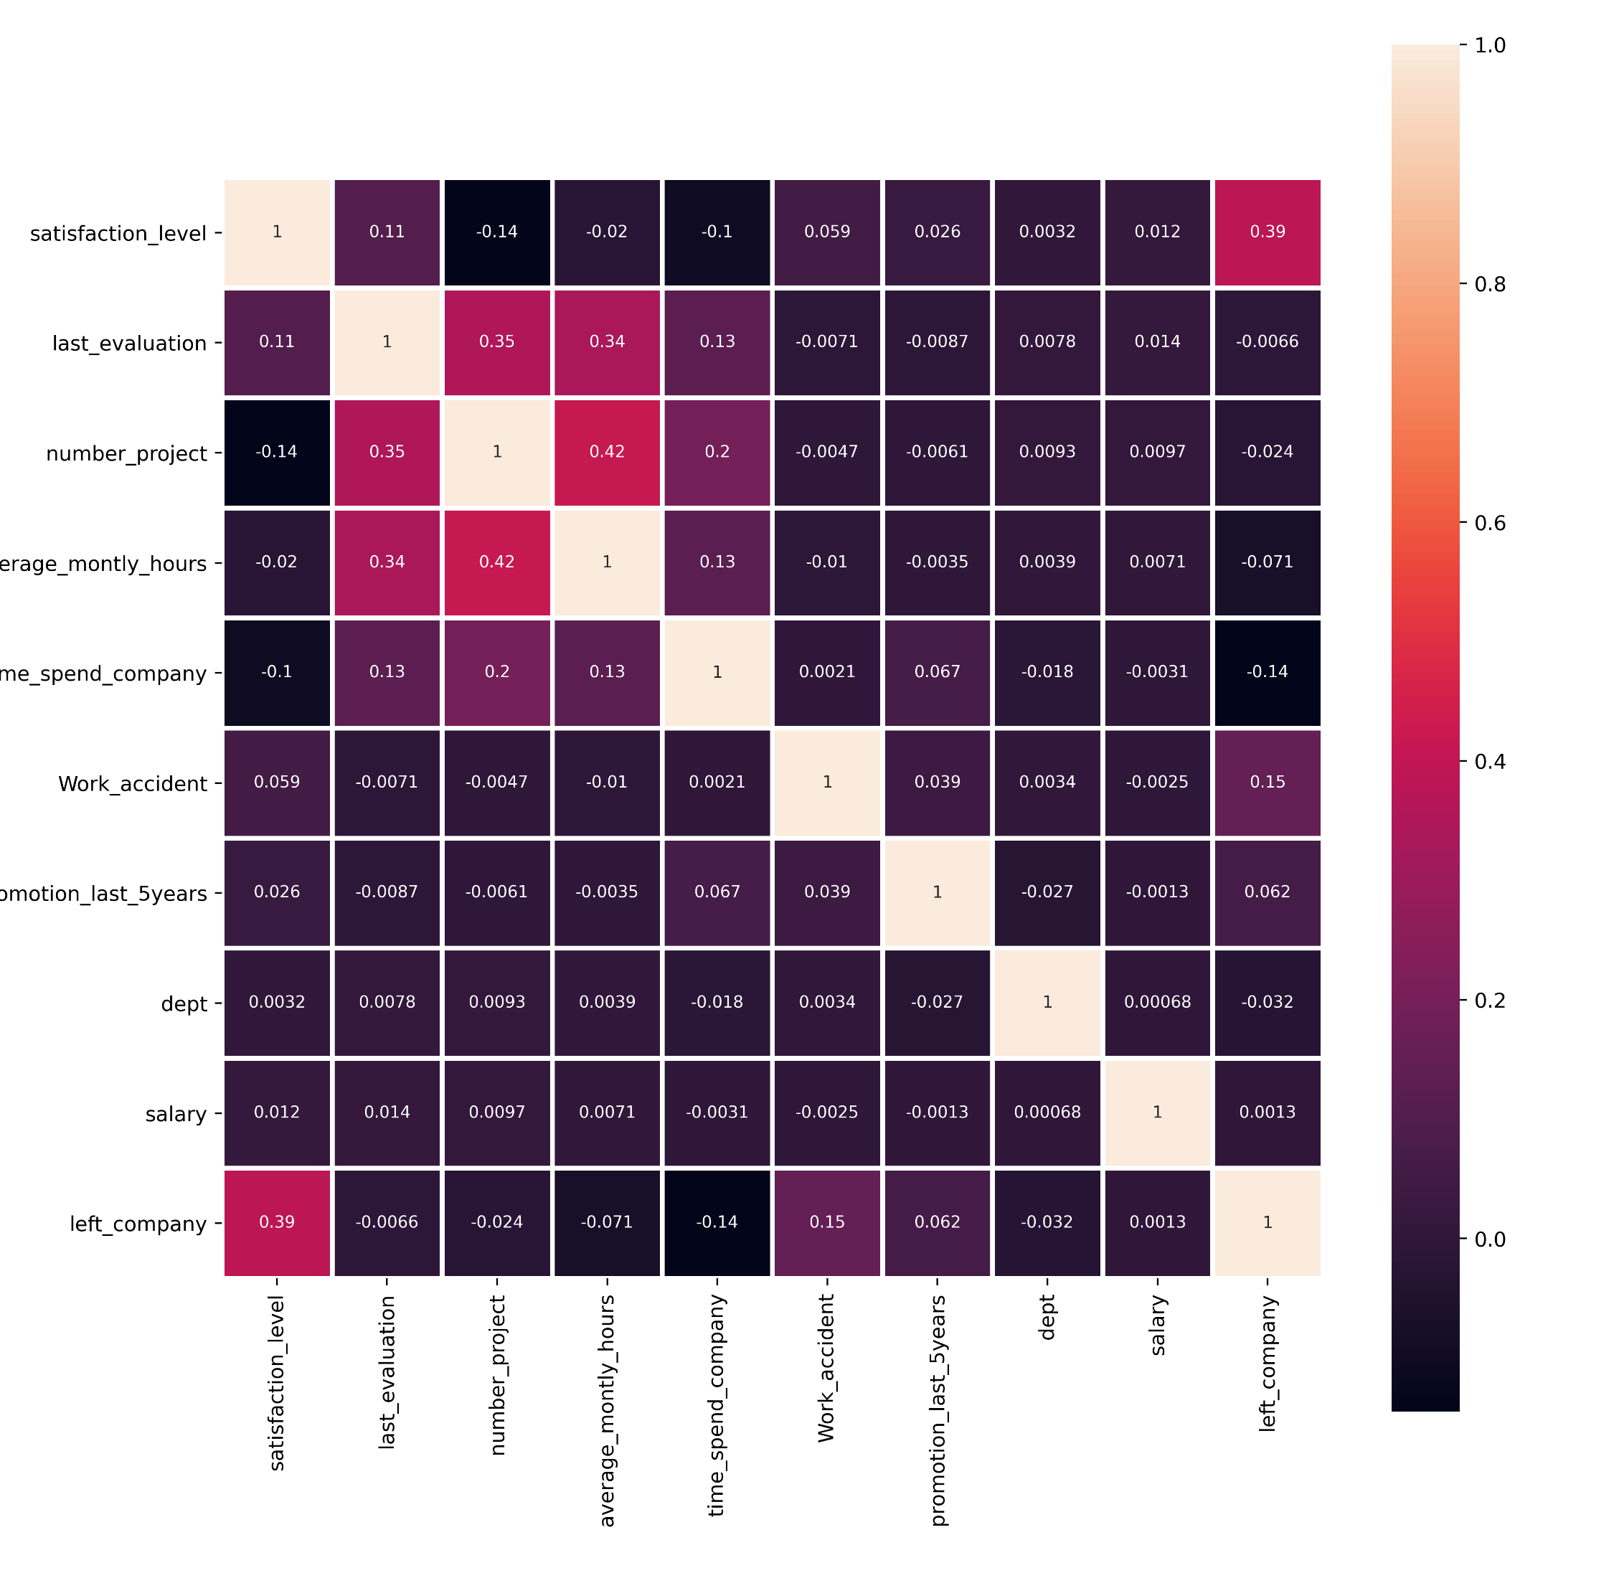
Data Analysis:
Heatmap analysis
A Heatmap of Correlation values of all the columns against employment status can be useful to find important factors.

Slide 9
Prediction:
Overview:
Adding Column “left_company” so that model could learn and predict who wil leave.
Merging both Datasets.
Splitting into training and testing datasets (80% and 20% respectively)
Testing accuracies of different models.

Slide 10
Prediction:
Prediction Models:
Linear Regression
Accuracy Score: 0.9777777777777777
Decision Tree
Accuracy Score: 0.9782222222222222
RandomForest
Accuracy Score: 0.98844444444444
Accuracy = 98.44% (Highest)

Slide 11
Predicted Data:
Results:
Emp Id | satisfaction_level | last_evaluation | number_project | average_montly_hours | time_spend_company | Work_accident | promotion_last_5years | dept | salary
4520 | 0.44 | 0.45 | 2 | 124 | 3 | 0 | 0 | sales | low
5698 | 0.81 | 0.98 | 6 | 196 | 2 | 0 | 0 | support | low
5832 | 0.28 | 0.46 | 4 | 260 | 2 | 0 | 0 | accounting | medium
6264 | 0.9 | 0.87 | 4 | 231 | 5 | 0 | 0 | management | low
6359 | 0.81 | 0.98 | 5 | 243 | 6 | 0 | 0 | sales | medium
7425 | 0.23 | 0.99 | 5 | 176 | 4 | 1 | 0 | sales | low
7990 | 0.36 | 0.45 | 2 | 135 | 3 | 1 | 0 | support | high
8473 | 0.23 | 0.47 | 4 | 277 | 5 | 0 | 0 | RandD | medium
8678 | 0.2 | 1 | 3 | 123 | 4 | 0 | 0 | support | low
8972 | 0.58 | 0.54 | 3 | 287 | 6 | 0 | 0 | technical | medium
9176 | 0.64 | 0.99 | 5 | 262 | 5 | 0 | 0 | sales | low
9537 | 0.28 | 0.94 | 6 | 167 | 3 | 1 | 0 | RandD | low
9583 | 0.43 | 0.51 | 2 | 123 | 3 | 0 | 0 | technical | medium
10099 | 0.73 | 0.83 | 5 | 266 | 5 | 0 | 0 | sales | low
14 employees might leave the company

Slide 12
Predicted Data:
1. Salary:
Salary | No. of Employees
low | 8
medium | 5
high | 1
Grand Total | 14

Slide 13
Predicted Data:
2. Number Of Promotions:
= 0
Salary | No. of Employees
low | 8
0 | 8
medium | 5
0 | 5
high | 1
0 | 1
Grand Total | 14
{
Number of Promotions

Slide 14
Predicted Data:
3. Last Evaluation:
Last Evaluation | No. of Employees
0.4-0.5 | 4
0.5-0.6 | 2
0.8-0.9 | 2
0.9-1 | 6
Grand Total | 14

Slide 15
Suggestions:
Overview:
From the given and the predicted data, we can see that employees with low salaries tend to leave the company. Thus, to prevent that the company may increase their salaries.
Similarly, Promoting employees who have not received any promotions in the last 5 years will prevent them from leaving.
Employees who have high evaluation scores tend to leave since they have not received a promotion or higher salary.
Similarly, Employees who have low evaluation scores tend to either leave or get fired.

